Slide 1
Diagnosis And Treatment Of Pulmonary Emboli In Pregnancy
A.Sardari.MD
Assistant Professor of Cardiology
Fellowship of echocardiography
Imam Khomeini Hospital Complex

Slide 2
VTE occurring in around 0.05–0.20% of all pregnancies, and rates of PE of around 0.03%.
-In women with previous VTE, recurrence rates are 7.6%.
-The risk of VTE is highest in the immediate post-partum
period(0.5%).
-The case fatality rate is 3.5%.
-Returns to the non-pregnant level after the sixth week post-
partum.

Slide 3
Hemostatic alterations during pregnancy

Slide 4
The gravid uterus compress the venous system
Enlarging iliac arteries compress the venous system
Endothelial injury

Slide 5
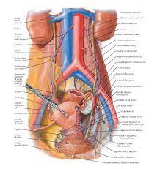

The significant venous stasis is observed more common in the left deep system because the right iliac artery compresses the left common iliac vein.

Slide 6
A high index of suspicion and a low threshold for investigation
high-risk women specifically

Slide 7
The optimal diagnostic approach for the pregnant patient with suspected PE is uncertain

Slide 8
Symptoms frequently overlap with those of normal pregnancy
(dyspnoea,cp, tachycardia, haemoptysis, and collapse).

Slide 9
In one study, indicating a 39% relative increase in D-dimer concentration for each trimester.
A negative D-dimer test helps to exclude VTE outside pregnancy,
but normal D-dimer
concentrations have
been reported in
pregnant with PTE
D-dimer levels continuously increase during pregnancy

Slide 10


Slide 11
Women with VTE,meaning that imaging remains the diagnostic
test of choice during pregnancy.

Slide 12
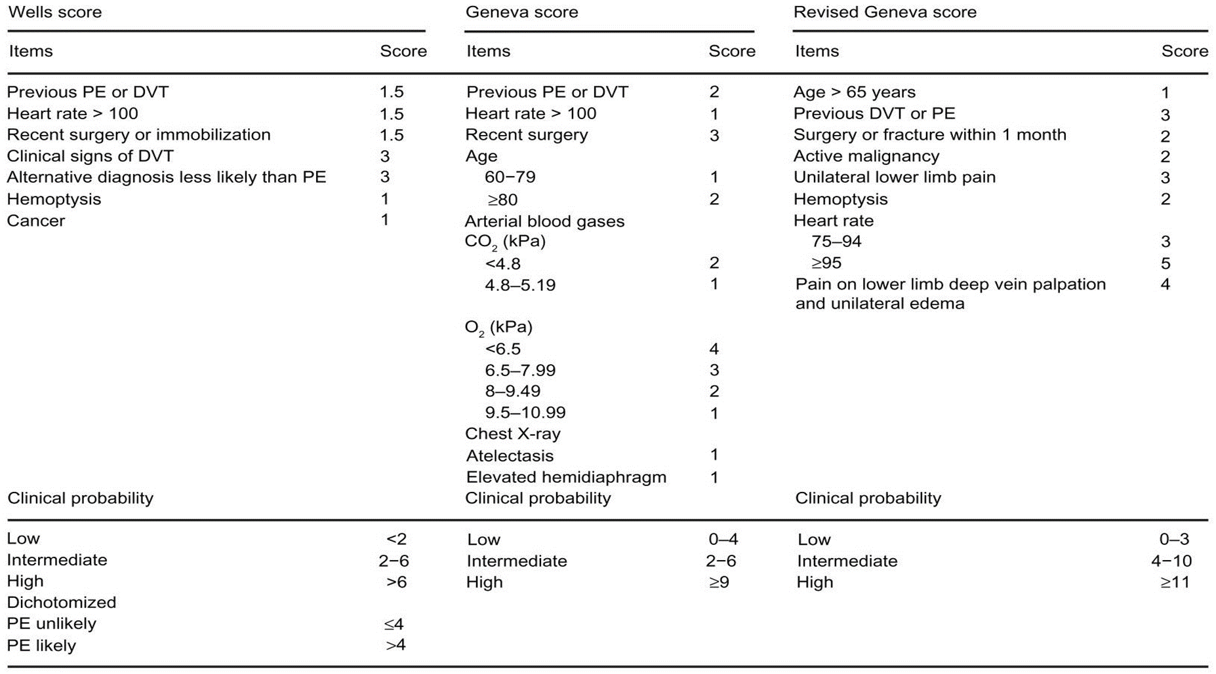

Slide 13
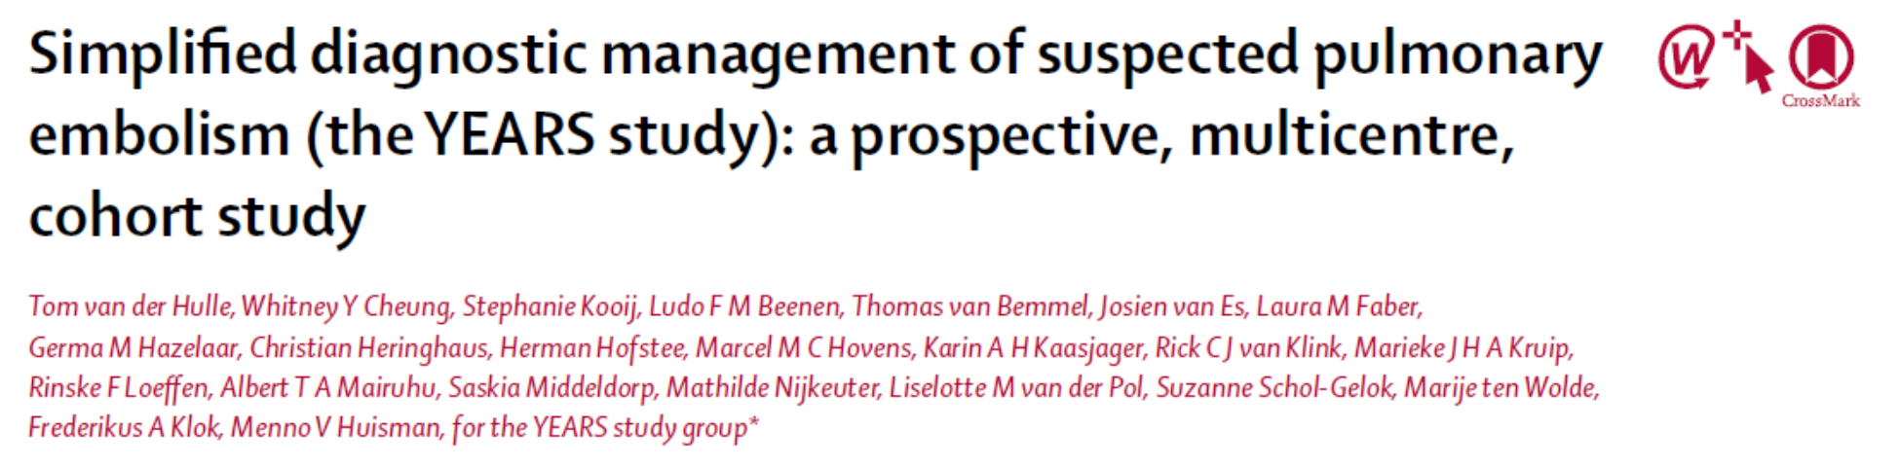

Slide 14
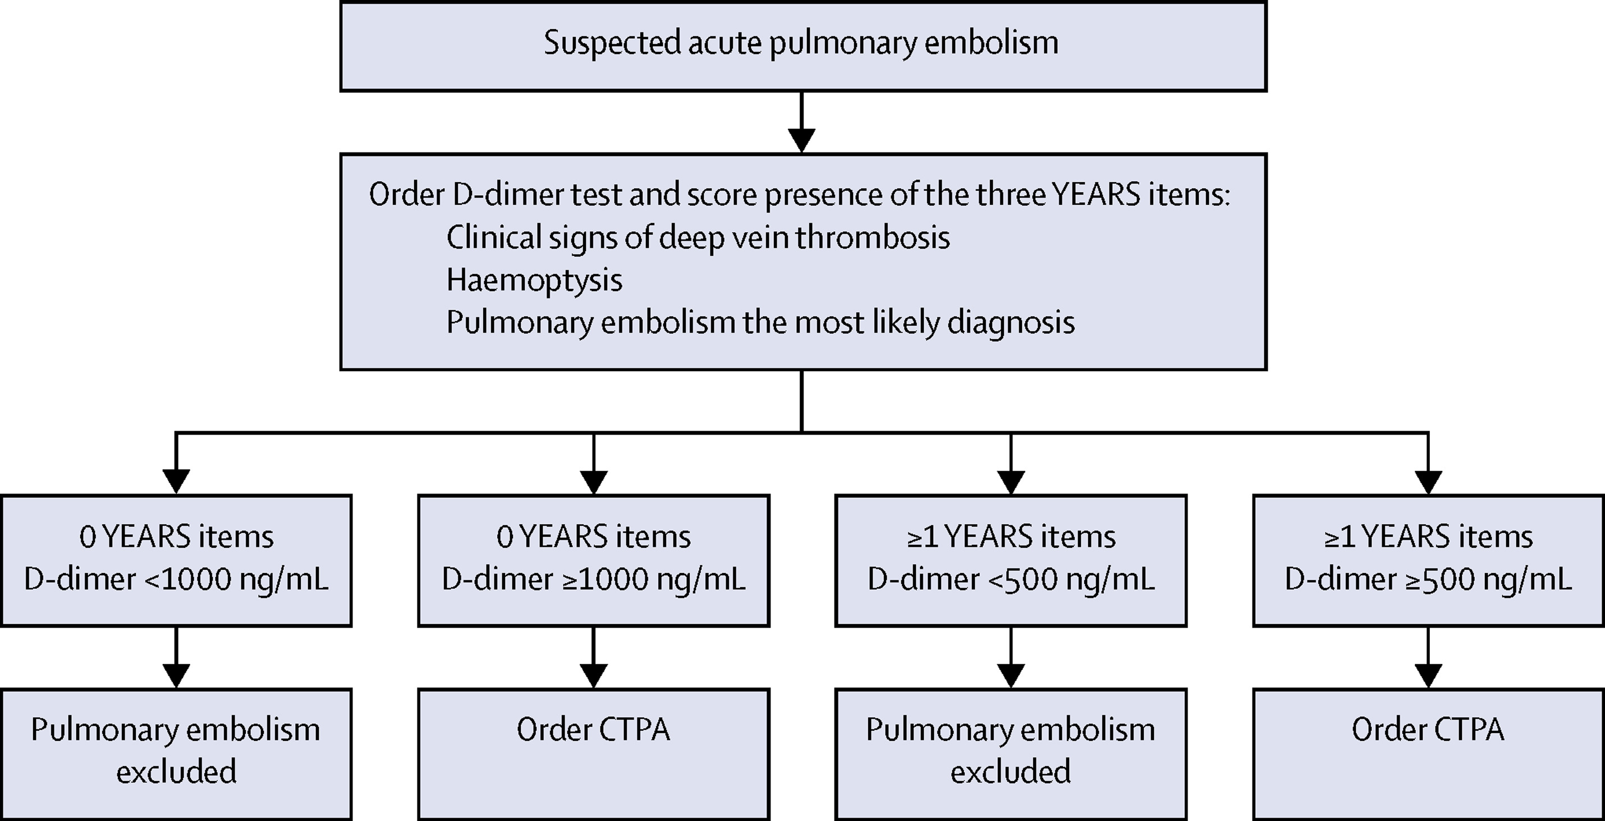

Slide 15
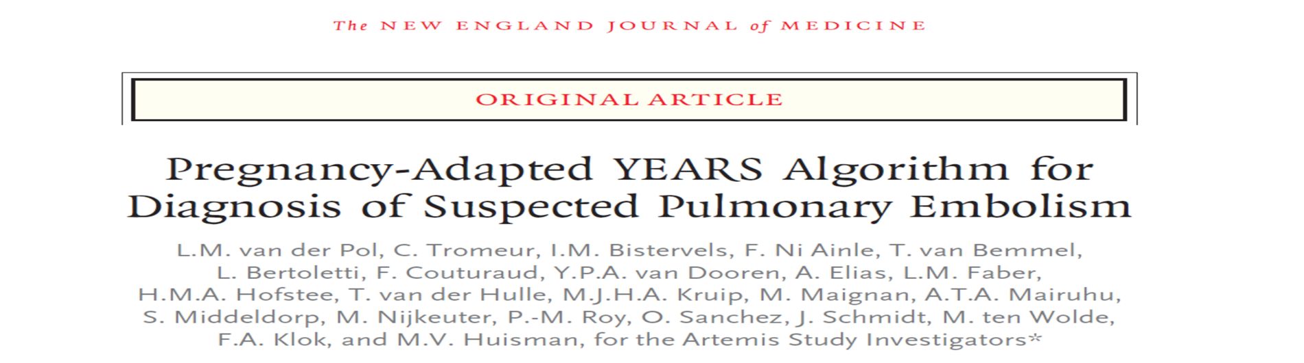
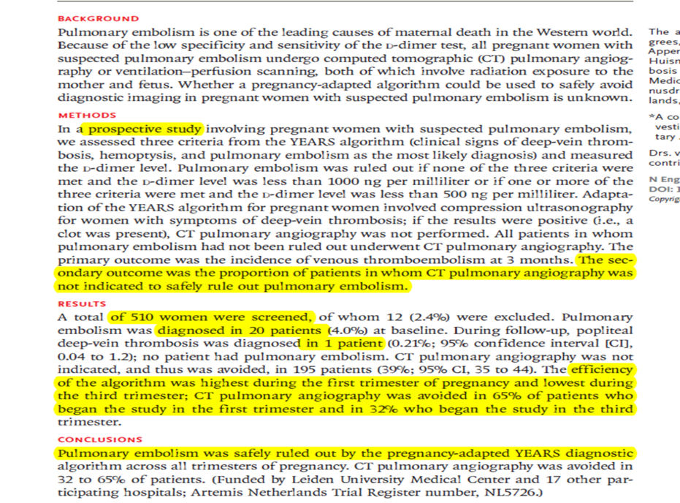

Slide 16
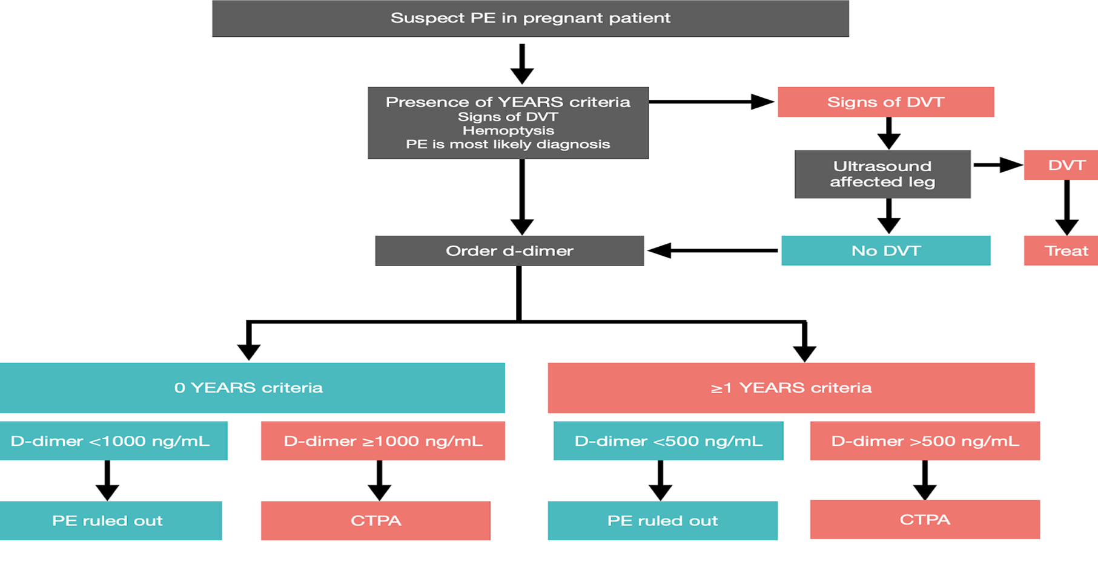

Slide 17
Compression ultrasound is choice for suspected DVT in pregnancy with a high sensitivity and specificity for proximal DVT, but less so for distal and pelvic DVTs.
CUS evaluations at days 0, 3, and 7 in pregnancy.
If CUS is negative, then further testing is required and MRV should be performed.

Slide 18


Slide 20
-Modern CTPA imaging
(maternal breast median doses as low as 3-4 mGy)
-Avoiding CTPA on the grounds of maternal cancer risk is therefore not justified
-V/Q planar is associated with low foetal and maternal radiation exposure

Slide 22
ASH guideline panel suggests (V/Q) lung scanning over (CT) Pulmonary angiography.
Lung perfusion scans should be considered the investigation of first choice for young women.(RCOG)
.
CTPA may not identify peripheral PTE (up to 30% small peripheral emboli missed), and may have a lower diagnostic yield due to the hyperdynamic circulation of pregnancy .

Slide 24
A normal perfusion scan and a negative CTPA appear equally safe
for ruling out PE in pregnancy
Initial choice of imaging is best determined by local expertise and resources.

Slide 25
Performing a thrombophilia screen is not routinely recommended .as the results are unlikely to influence management.

Slide 26
Echocardiographic examination is not mandatory as part of the routine diagnostic workup in haemodynamically stable patients ( may be useful in the differential diagnosis of acute dyspnea)
Echo probably have low sensitivity ,they were reported to be normal in haemodynamically stable patients despite the presence of PE.

Slide 27
- In a haemodynamically compromised patient with suspected PE, unequivocal signs of RV pressure overload(60/60 sign, McConnell sign, or right heart thrombi), justify emergency reperfusion treatment for PE .

Slide 30
Treatment

Slide 31

UFH is safe in pregnancy (does not cross the placenta, and consequently
does not confer a risk of foetal haemorrhage or teratogenicity).
Restricted to patients with overt haemodynamic instability or imminent haemodynamic decompensation (primary reperfusion treatment)
Serious renal impairment [creatinine clearance (CrCl) <_30 mL/min] or severe obesity
The use of UFH has been associated with HIT and bone loss.

Slide 32
Loading dose of 80 units/kg -> continuous intravenous infusion of 18 units/kg/hour
Thrombolysis ,the loading dose of heparin should be omitted.
Measure (APTT) level 4–6 hours after the loading dose, 6 hours after any dose change and then at least daily (1.5-2.5).
UFH should have platelet count monitoring performed every 2–3 days from days 4 to 14 or until heparin is stopped.

Slide 33
APTT monitoring of UFH is technically problematic, particularly in late pregnancy when an apparent heparin resistance occurs (increased fibrinogen and factor VIII)
High doses of heparin being used with subsequent haemorrhagic problems.
With UFH, a lower level of anti-Xa is considered therapeutic (target range 0.35–0.7 u/ml or 0.5–1.0 u/ml for patients with life-threatening PE).

Slide 34
Where the problem persists or in women with HIT, the use of danaparoid, a low-molecular-weight heparinoid, can be considered

Slide 36
LMWH is the treatment of choice for PE during pregnancy.
LMWH has more predictable pharmacokinetics and a more favourable risk profile.
LMWH does not cross the placenta, and consequently does not confer a risk of foetal haemorrhage or teratogenicity.
No osteoporosis or osteoporotic fractures were reported.
Bleeding and recurrence of VTE is low.

Slide 37
Although no RCT has evaluated the optimal dose of LMWH for the treatment of PE during pregnancy, data favour similar dosing to non-pregnant patients( based on early pregnancy weight 1 mg/kg body weight twice daily or 1.5mg/kg/d).
Anti-activated coagulation factor monitoring may be reserved for specific high-risk (recurrent VTE, renal impairment, and extremes of body weight).
4–6 h peak anti-Xa values of 0.6–1.2 IU/mL

Slide 38
Dose adjustment required in obese patients with a BMI ≥ 40 kg/m2.
Consider enoxaparin 0.75 mg/kg bid (therapeutic dosing) .
Consider anti-Xa monitoring.

Slide 39
Routine platelet count monitoring should not be carried out.
The platelet count should be checked after 24 hours of initiating treatment if the patient has previously received heparin (unfractionated or LMWH) in the last 100 days.

Slide 41
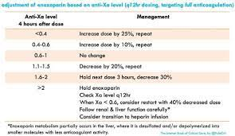

Slide 42
Because of their adverse effects on the fetus, vitamin K antagonists, such as warfarin, should not be used for antenatal VTE treatment.

Slide 43
In patients with high or intermediate clinical probability of PE, anticoagulation should be
initiated while awaiting the results of diagnostic tests.
LMWH and fondaparinux are preferred over UFH for initial anticoagulation in PE
(lower risk of inducing major bleeding and HIT).
Neither LMWH nor fondaparinux need routine monitoring of anti-Xa levels.

Slide 44
Fondaparinux (7.5 mg once a day in normal weight pregnant women) can be considered if there is an allergy or adverse response to LMWH(minor transplacental passage)

Slide 45
Reperfusion treatment

Slide 48
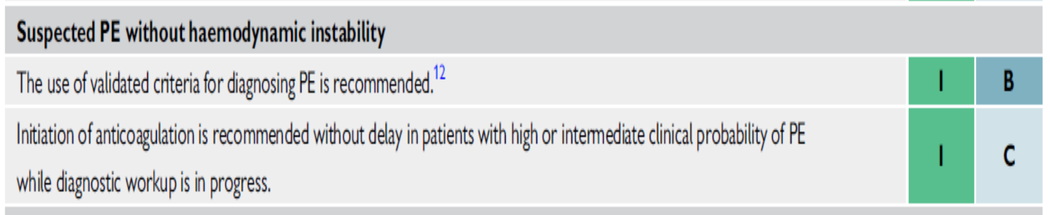

Slide 49


Slide 50
- The greatest benefit ->within 48 h of symptom onset ,but thrombolysis can still be useful in patients who have had symptoms for 6-14 days.
Unsuccessful thrombolysis(8% of high-risk PE patients):
- Persistent clinical instability
- Unchanged RV dysfunction on echocardiography after 36 h

Slide 52
Newer, unapproved agents for the PTE treatment are tenecteplase and reteplase.

Slide 53
If aPTT is less than twice the normal upper limit (<80 s), UFH is resumed at 18 IU/kg/h without a loading dose.
If aPTT is still >80 s, measurement should be repeated every 4 hours, and UFH therapy should be resumed when it reaches <80 s.

Slide 54
For patients who were treated with LMWH prior to thrombolytic therapy, UFH infusion is initiated after 12 or 24 hours depending on the type of LMWH.

Slide 55
Thrombolytic treatment should not be used peri-partum, except in the setting of life-threatening PE.

Slide 56
Percutaneous catheter-directed treatment

Slide 57
Mechanical reperfusion is based on the insertion of a catheter into the pulmonary arteries via the femoral route.
Different types of catheters are used for mechanical fragmentation, thrombus aspiration, or more commonly a pharmacomechanical approach combining mechanical or ultrasound fragmentation of the thrombus with in situ reduced-dose thrombolysis

Slide 58
Surgical embolectomy

Slide 59
Recent reports have indicated favourable surgical results in high risk PE, with or without cardiac arrest, and in selected cases of intermediate-risk PE.

Slide 60
Vena cava filters

Slide 61
The aim of vena cava interruption is to mechanically prevent venous clots from reaching the pulmonary circulation.
Most devices in current use are inserted percutaneously and can be retrieved after several weeks or months, or left in place over the long-term.

Slide 66
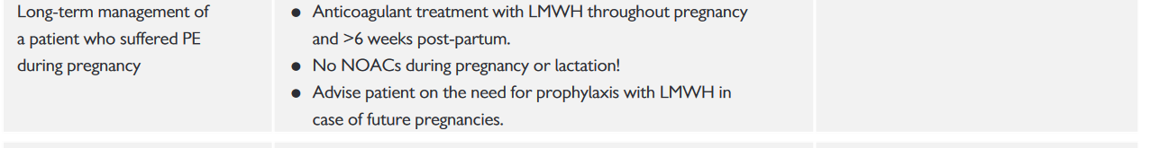


Slide 67
Anticoagulant treatment should be administered for >_6 weeks after delivery and with
a minimum overall treatment duration of 3 months.
LMWH and warfarin can be given to breastfeeding mothers; the use of NOACs is not recommended

Slide 68
VKAs cross the placenta and are associated with a well-defined embryopathy during
the first trimester.
Administration of VKAs in the third trimester can result in foetal and neonatal haemorrhage,
as well as placental abruption.
Warfarin may be associated with central nervous system anomalies in the foetus throughout pregnancy.
NOACs are contraindicated in pregnant patients.

Slide 69
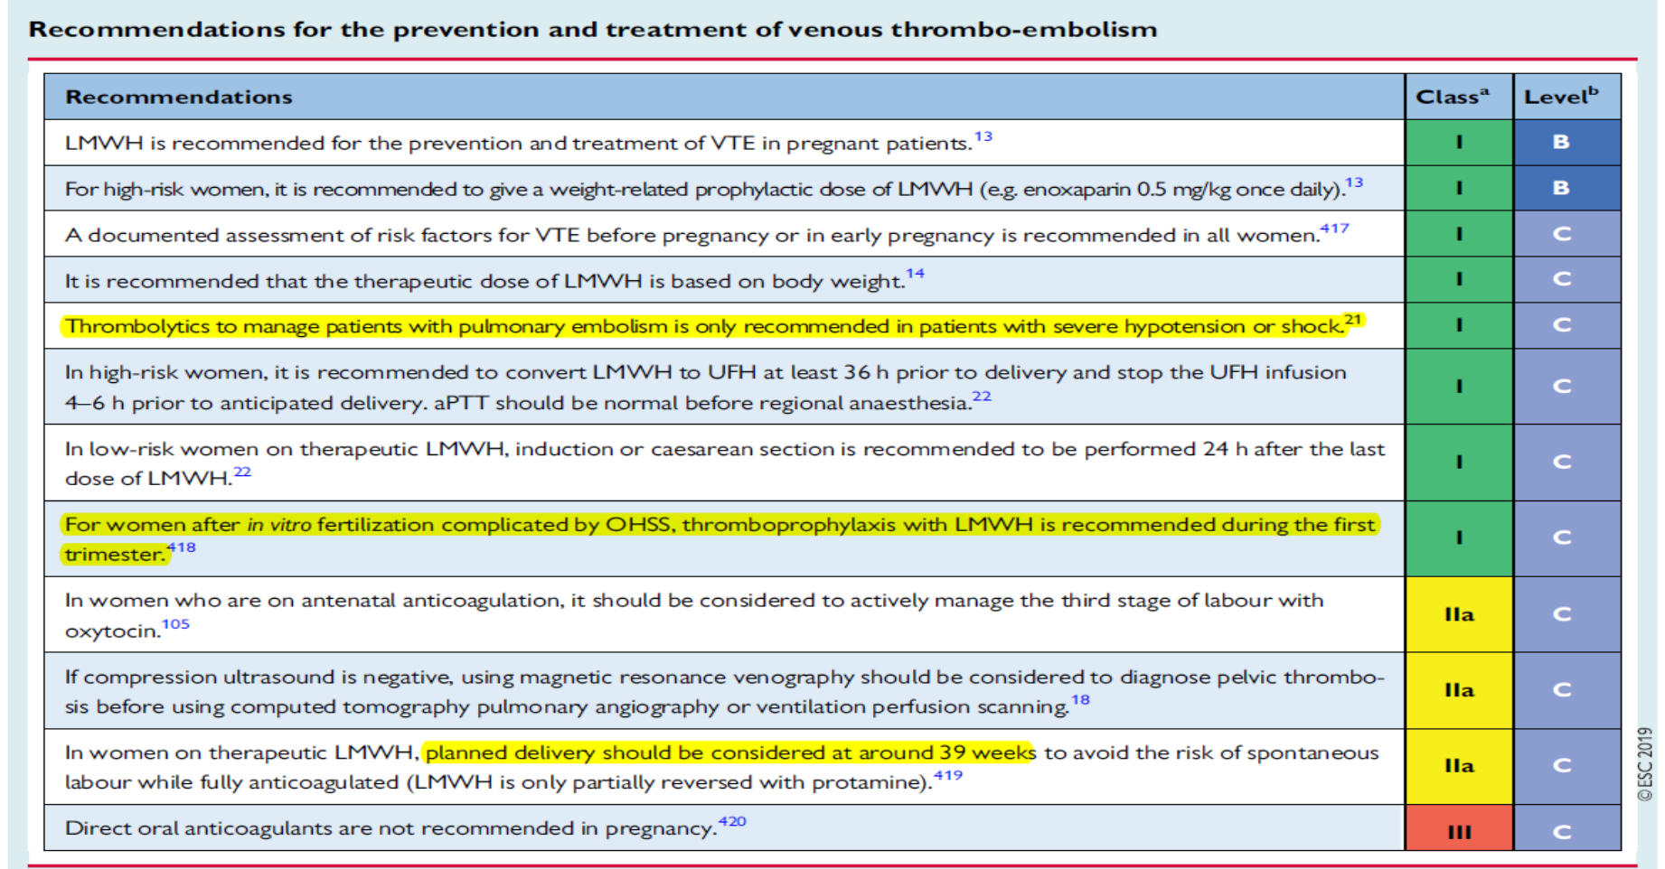


Slide 70



